Slide 1
Jacobson’s Relaxation exercise

Slide 2
Overview
Jacobson’s relaxation technique is a type of therapy that focuses on tightening and relaxing specific muscle groups in sequence. It’s also known as progressive relaxation therapy. By concentrating on specific areas and tensing and then relaxing them, you can become more aware of your body and physical sensations.

Slide 3
Dr. Edmund Jacobson invented the technique in the 1920s as a way to help his patients deal with anxiety. Dr. Jacobson felt that relaxing the muscles could relax the mind as well. The technique involves tightening one muscle group while keeping the rest of the body relaxed, and then releasing the tension.

Slide 4
Benefits
relieving anxiety
reducing work-related stress
lowering your blood pressure
reducing the likelihood of seizures
improving your sleep

Slide 5
Requirements of Environment:
The setting for relaxation is quiet and of distraction noises. The client Will be kept physically comfortable in a position.

Slide 6
General Instruction (Before and During Muscle Relaxation Exercise):
This instruction is kept simple and is easily understood by students exposed to jacobson’s progressive muscle relaxation technique and gives them a clear picture of how to co-operate during the exercise regimen.
a) To sit on a chair as comfortably as possible. Keep your body loose ..................... light..................and free.
b) Be calm and comfortable.
c)Keep your eye closed.
d)Avoid stray thoughts.
e) Avoid extra movements of the body

Slide 7
f) During the part of the exercise cycle tense the muscle tightly and hold for slow count of 5 seconds. (Repeat silently 1001, 1002, 1003,…)
g) During the relation part of exercise cycle relaxes the muscle quickly and completely .let your mind relax and appreciate how relaxed the muscle is feeling for 10 seconds.
h) Try to keep all other muscles relaxed as you exercise specific muscle group

Slide 8
As you exercise from head to toe................ Observe changes like tightness and the development of light and soothing sensations.
j) Relax by taking three deep breaths inhaling through nose and exhaling through mouth after each step.
k) Now make your body completely loose.............light.............. and free
l) Let us being your exercise

Slide 9
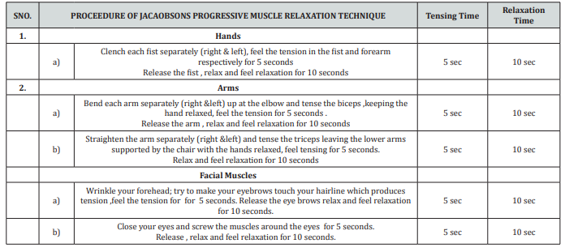

Slide 10
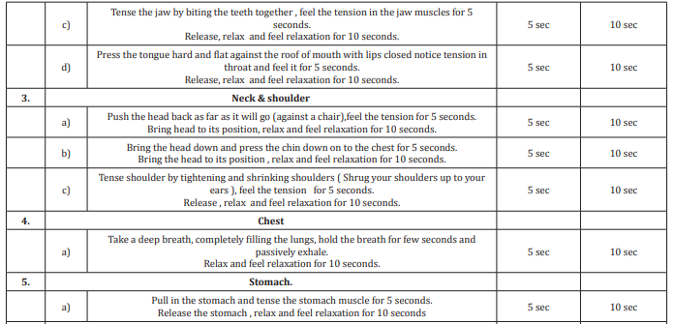

Slide 11
